Slide 1
Adapter Pattern
By
Narendran, S S

Slide 2
Key Items
IS A and HAS A Relationship
AKA Wrapper
Adapter Using Inheritance / Class Adapter
Adapter Using Composition / Object Adapter
Impedance Matching
Single, Double & Multi Purpose Adapter
Adapter can also act as Transformers, Regulators.
Notes:
Should the Type of Input & output be same in Adapter? Ans NO Adapter becomes Transformers/Filters, when they are same.

Slide 3
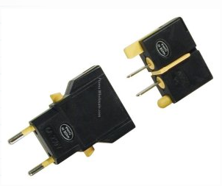
Adapter Pattern
In computer programming, the adapter pattern (often referred to as the wrapper pattern or simply a wrapper) is a design pattern that translates one interface for a class into a compatible interface.

Slide 4
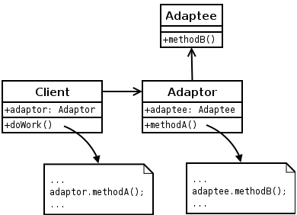
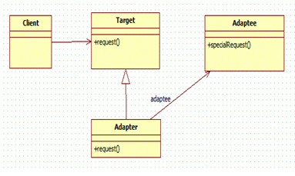
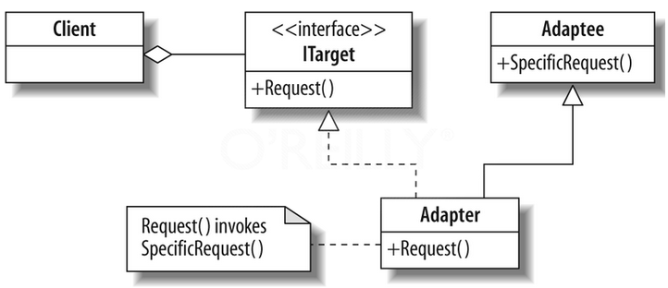
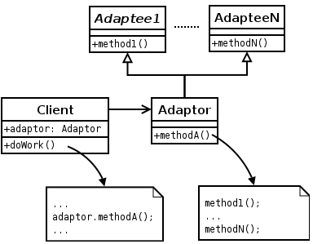
Adapter Pattern - UML
Single Adaptor
By Composition
Multi purpose Adaptor
By Inheritance

Slide 5
Pros and Cons
Pros
An “off the shelf” component offers compelling functionality that you would like to reuse, but its “view of the world” is not compatible with the philosophy and architecture of the system currently being developed.
Adapter is retrofitted to make unrelated classes work together.
Design a “wrapper” class that can “impedance match” the adaptee to the client.
Adapter can be changed to fit with any adaptee class without any change in Client Parts.
Cons
Some say that the Adapter pattern is just a fix for a badly designed system, which didn't consider all possibilities. While this is a fair point, it is an important part of a pluggable architecture. It can also add a level of complexity to your code, making debugging more difficult.

Slide 6
References
http://userpages.umbc.edu/~tarr/dp/lectures/Adapter.pdf
http://www.tutorialspoint.com/design_pattern/adapter_pattern.htm
http://javapapers.com/design-patterns/adapter-pattern/
http://www.oodesign.com/adapter-pattern.html
http://sourcemaking.com/design_patterns/adapter

